Slide 1
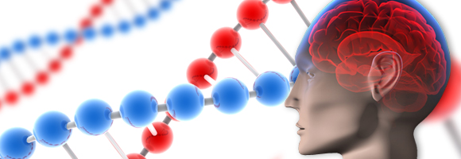
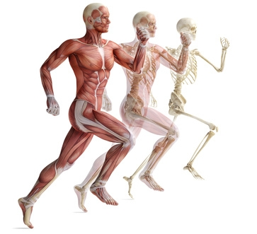
Cell Transport
Active

Slide 2
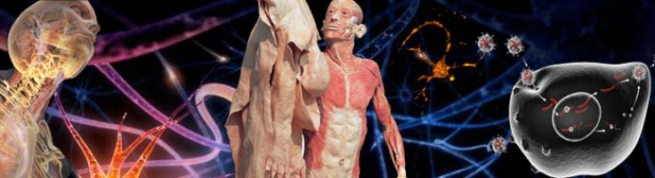
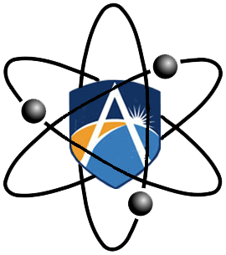
Objective
Define Active transport.
Understand the importance of Surface area to Volume ratios in the function of cells.

Slide 3
What is active transport?
Some materials need to be moved in the opposite direction to diffusion and osmosis.
They require active transport from the cell.
Active transport requires energy because it is the movement of nutrients from areas of low to areas of high concentration.

Slide 4

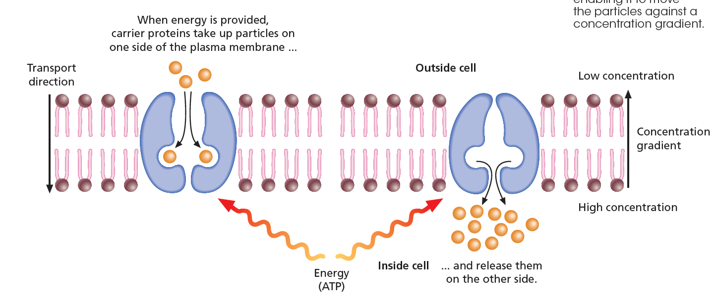
Active transport – through protein.
Notes:
How does active transport take place? Membrane transport proteins, similar to those responsible for facilitated diffusion, use energy from adenosine triphosphate (ATP) to move molecules or ions up their concentration gradient (Figure 8.19). As these carrier proteins work in only one direction, they effectively act as one-way valves.

Slide 5
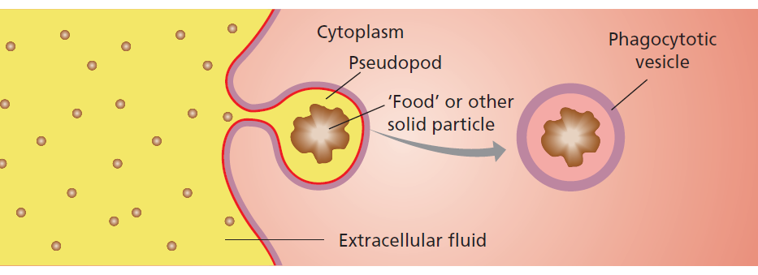
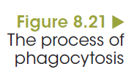
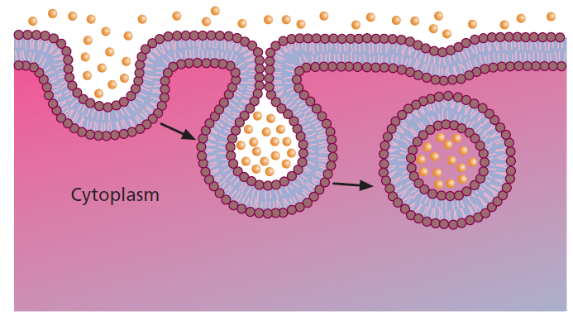

Endocytosis
Active transport – through endocytosis.
Notes:
The two types of endocytosis discussed in this chapter are named according to the type of material consumed. The process that engulfs solids, like an amoeba eating, is called phagocytosis and the other process that takes in droplets of liquid is pinocytosis.

Slide 6
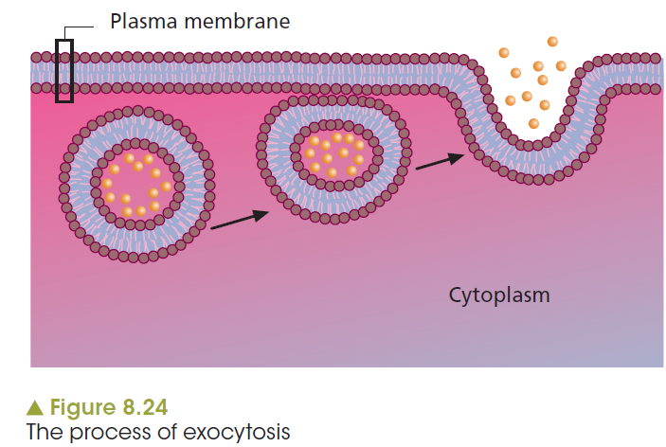
Exocytosis
Active transport – through exocytosis.
Notes:
Specialised animal cells produce a variety of substances, such as hormones, mucus, milk proteins and digestive enzymes, which have important functions elsewhere in the organism. This is also true for plants, where particular cells are specialised to produce products that need to be relocated. These include growth regulators, toxins to ward off predators and macromolecules for use elsewhere. In all these cases, exocytosis is involved.

Slide 7
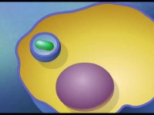
The function of endocytosis and exocytosis

Slide 8

Summary cell active transport
https://www.youtube.com/watch?v=eDeCgTRFCbA

Slide 9
Lego Demo
Surface Area to Volume Ratio

Slide 10
Size and shape of cells
Factors affecting the exchange of materials
Surface-area-to-volume ratio
Needs a large surface area in relation to its volume.
A large surface-area-to-volume ratio.
As cells grow larger, the volume grows faster than surface area.
The surface-area-to-volume ratio decreases.
Notes:
An important concept related to exchange across membranes is the surface-area-to-volume (SA:volume) ratio. This ratio may be expressed as a single number, for example 3, or a ratio, for example 3:1. It represents an important relationship between the area of the membrane surrounding a cell and the volume of its cytoplasm.
Surface area is the area of membrane around the cell and the volume is the amount of cytoplasm.

Slide 11
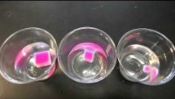
What is the advantage of the cells being small?

Slide 12
Many specialized organs effectively increase the surface areas available for exchange processes to be as efficient as possible.
These include the:
Lungs – alveoli used to maximize exchange of gases.
Kidneys – nephrons used to clean the blood and excrete water rapidly and efficiently.
Small intestines – villi to absorb water and nutrients efficiently across a large surface area.

Slide 13
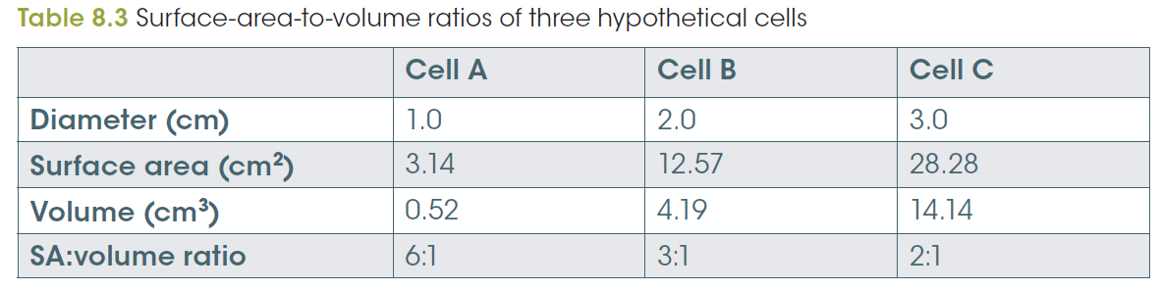
Size and shape of cells
Factors affecting the exchange of materials
Notes:
Surface area is the area of membrane around the cell and the volume is the amount of cytoplasm. This is shown in Table 8.3. Cell A has a volume of 0.52 cm³ and a surface area of 3.14 cm² to service it. This is a surface-area-to-volume ratio of 6:1. Cell C, however, has a volume of 14.14 cm³ and a surface area of 28.28 cm² to service it, a surface-area-to-volume ratio of only 2:1.

Slide 14
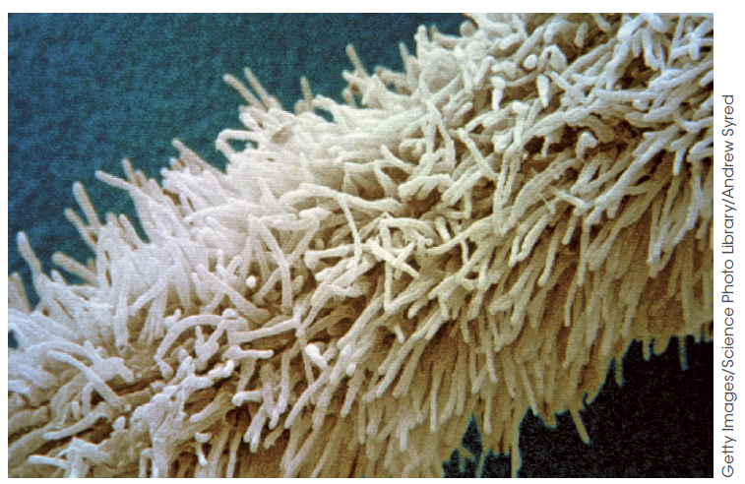
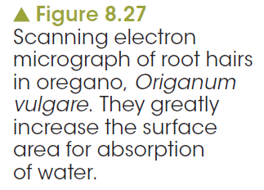
Some cells need to be large
Some cells like marjoram, muscle and nerve cells are very large.
How do they cope?
Depends on function.
Shape affects SA:V ratio.
Very thin, cylindrical axon can be up to a metre long.
Marjoram extends root hairs to increase SA:V ratio.

Slide 15
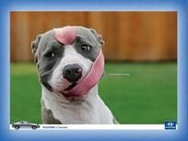
Have a Brilliant Day ☺

